Slide 1
Stirrup Key Harbor Overview Jan 2019
“Stirrup Key, Keep on doing whatever you are doing.
It is working.”
Rhonda Hague, Monroe County Sustainability Director. Responsible for compliance with US Congress Clean Water Act. She wrote that the June 2017 county wide water quality analysis conducted by FIU showed a nearly three-fold improvement in Stirrup Key canal water quality. This is important. More on it shortly. But first a few harbor actions since last year*

Slide 2
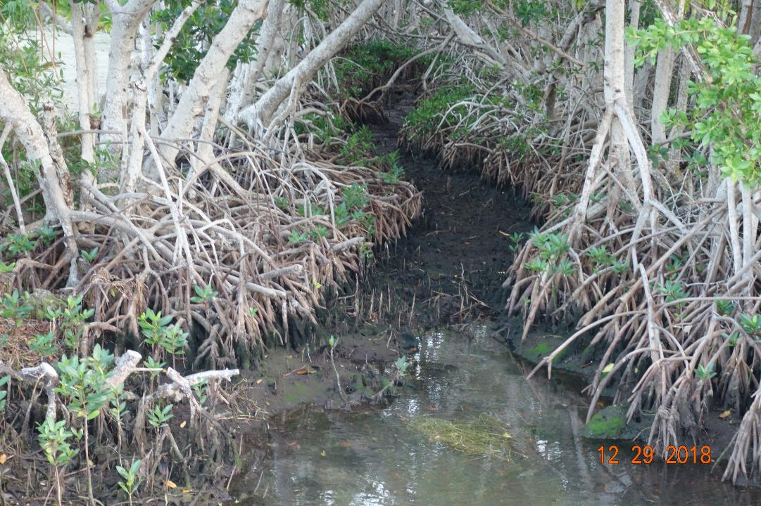
Sergio got Property Doctors to obtain a permit and clear a swath of mangrove roots along the first flushing canal. The permit belongs to SKHOA and we can continue progress under that permit
This is a big deal
One action for SKHOA to comply with the Clean Water Act under the FKRAD is enhanced flushing thru the first flushing canal. This is a key first step.

Slide 3
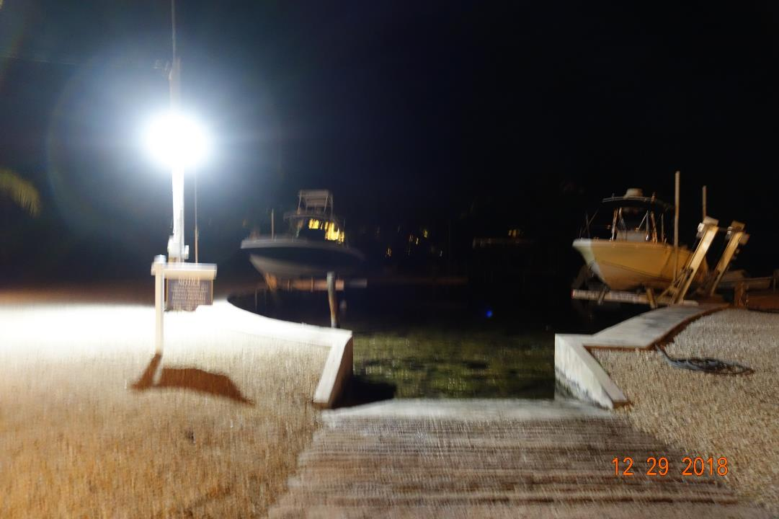
We had an overhead Boat Ramp Light installed– for Safety and it makes the ramp more useable

Slide 4
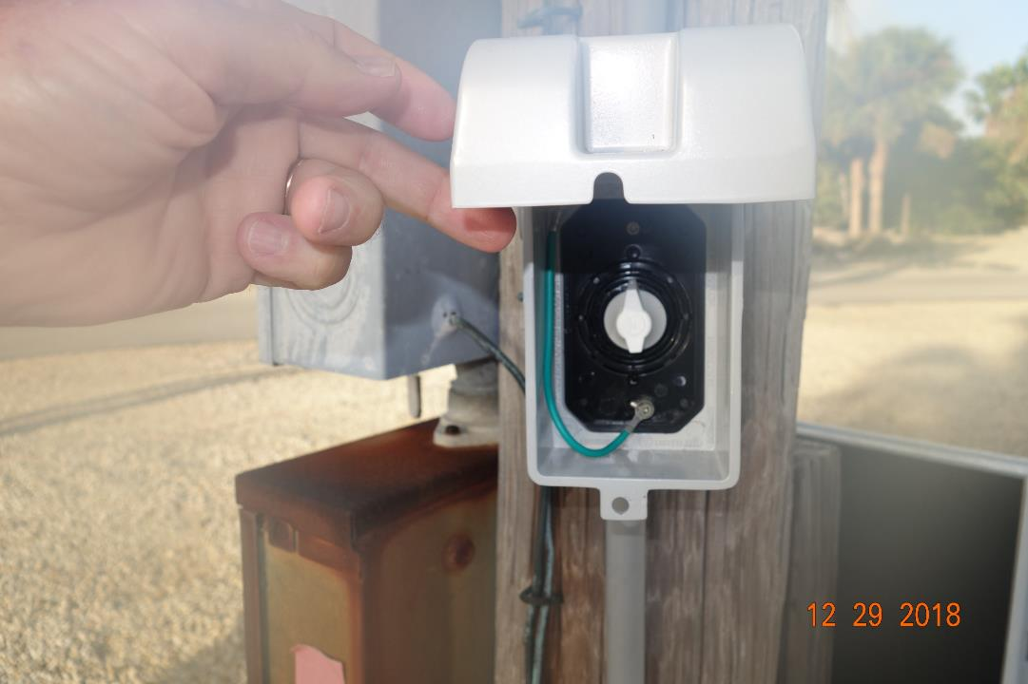
An Automatic timer was installed on the boat ramp light pole, so the ramp light turns off automatically

Slide 5
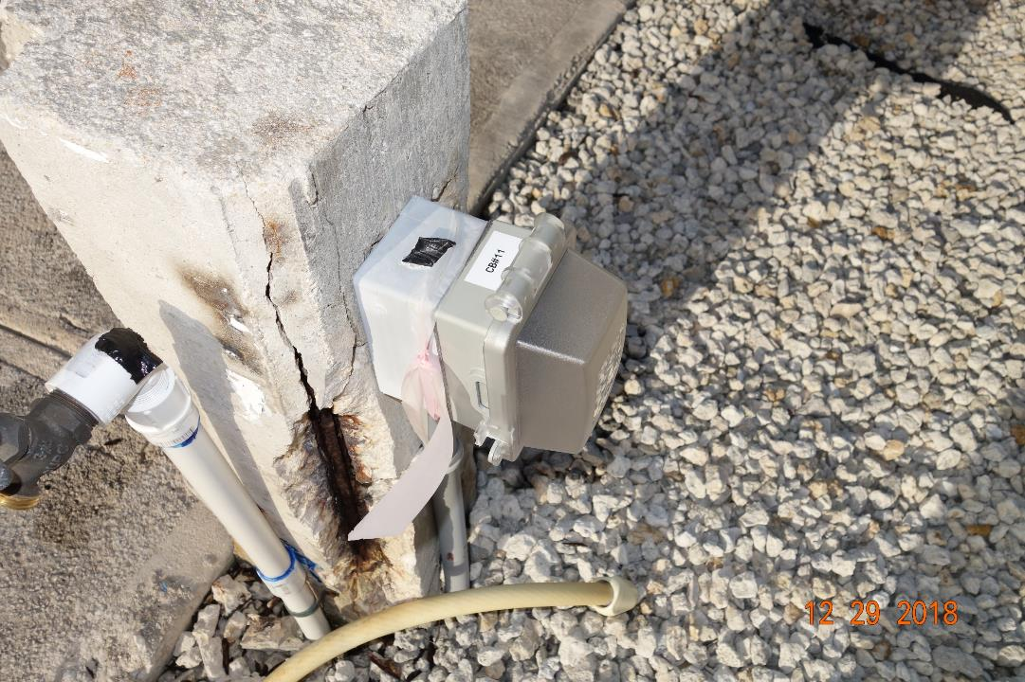
Sergio & Tim Heise got Tim's electrician to replace a bunch of bad GFI outlets, bad wiring and bad circuit breakers around both marinas- Most outlets have
breaker numbers now.

Slide 6
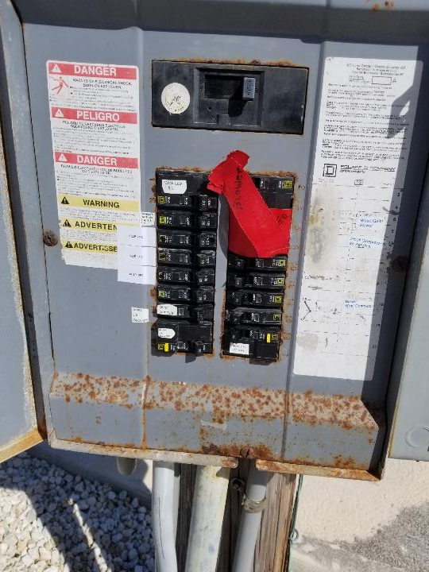
Breaker panel full. And has a lot of corrosion internally.
We Need new larger panel. There will be additional large boats with lifts but no breaker space is available.
&
We have needed a heavier underground wire to the old, small blower since it was installed – undersize wire causes bearings to burn out repeatedly
So Dr Bob Has to load blower into his pickup by front end loader, take to Miami - go back to Miami - load off of pickup into front end loader and reinstall – This has been going on for ten years –
It is Way past time to correct this.

Slide 7
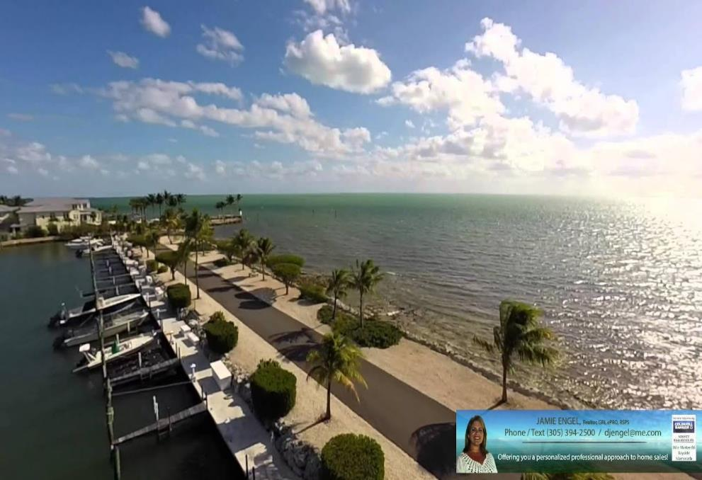
Hurricane Irma pretty much destroyed the road, common area on both sides, including palms, shrubs, dock electricity and plumbing as well as play ground and pick nick facilities. All were replaced within 9 months after Irma because the professional HOA manager had contractors and engineers, permitting contacts, By-Laws and funding lined up in advance. SKHOA has had an undersized weed gate blower and undersized electrical line to the blower for 8 years causing an absurd amount of maintenance effort by Dr Bob, a volunteer. WHY HAVE WE NOT CORRECTED THESE TWO SMALL RELATIVELY MINOR PROBLEMS IN EIGHT YEARS WHEN OTHER HOA’S HAVE DONE SO MUCH MORE QUICKLY RIGHT AFTER IRMA?

Slide 8
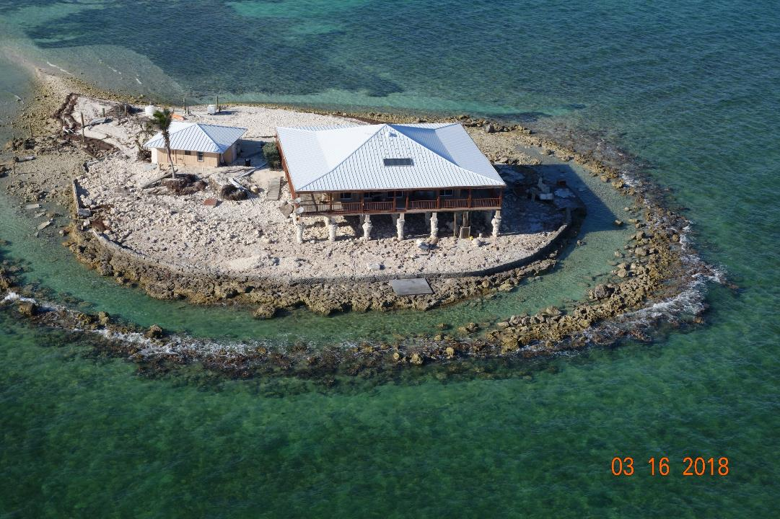
Island house off of Sombrero subdivision after Irma.

Slide 9
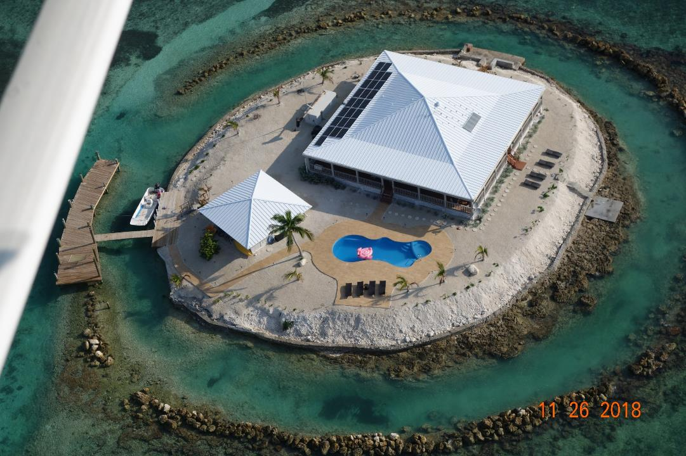
Totally Redone 9 months later but after 8 years SKHOA still has defective wire to our weed gate blower and even though a member DONATED the needed larger blower, Dr Bob has to spend enormous effort repairing the old inadequate system. WHY?

Slide 10
*Stirrup Key Is In Violation Of US Congress Clean Water Act
Along With Many Other Canals In Monroe County
The Florida Keys Reasonable Assurance Document (FKRAD) Allows Time For A Panel Of Experts To Analyze Each Canal & Develop Management Plans (Including Plans To Tax Canal Residents)
So “Keep Doing What You Are Doing. Its Working” Is Good News For Us From Ms. Hague! But SKHOA needs to work closely with City officials to 1. avoid being taxed for things we have done on our own 2. to learn what we can do to become eligible and a priority for grant funded muck removal and 3. to identify specialty contractors so we can do muck removal better and cheaper on our own if needed rather than face up to a $10,000 per lot assessment for compliance!

Slide 11
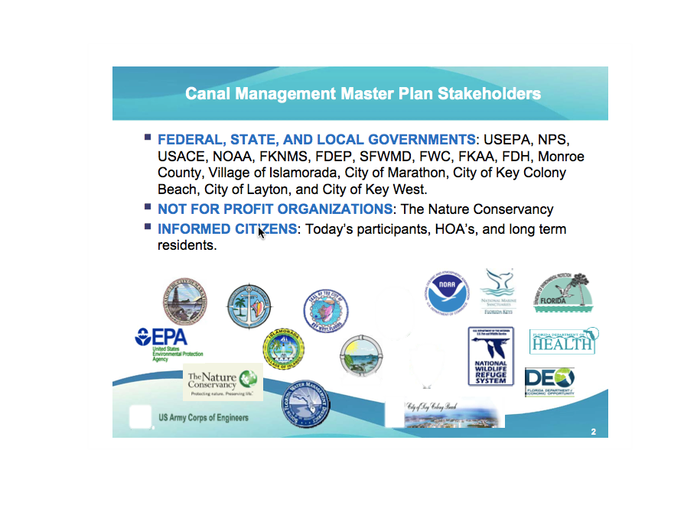
These Are The Expert Agencies involved in planning for Monroe County Clean Water Act Compliance under the FKRAD

Slide 12
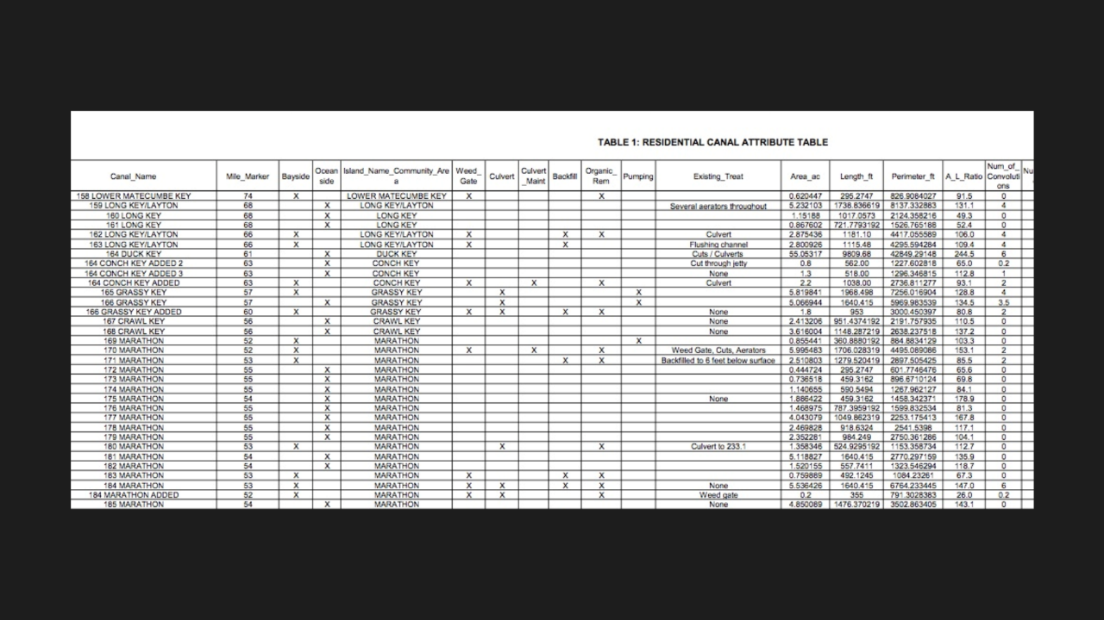
All of the details about this are on the Monroe County web site. We are canal 170 in the spread sheet below. The expert panel calls for us to have seaweed barriers, enhance flushing canal function and dredge muck. Aeration has since been called for. We have all either established or underway except dredging. We need to keep them operational.

Slide 13
“Keep Doing What You Are Doing. Its Working” So from a FKRAD perspective we are ahead in compliance - with four seaweed barriers and a harbor aeration system and have started restoring function of the first flushing canal
The remaining item called for by the Monroe County Canal Management Master Plan is removal of the anaerobic (toxic) seaweed sediment which is a blatant, (and a critical Clean Water Act violation) in the Windy Point marina. This has to be a focus of our association now.

Slide 14

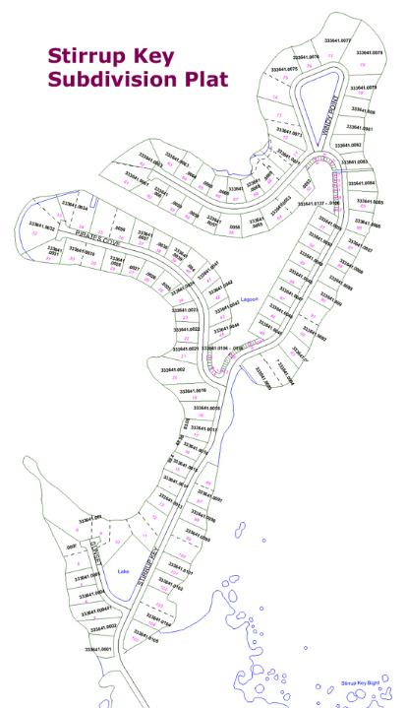
This is what SKHOA has been doing.
Main seaweed barrier at canal entrance here --------------------------
Two barriers in second flushing canal, ---------- here
------------------aeration here
Aeration here---------------
-----------------Inner seaweed barrier here
----------First step in enhancing flushing thru first flushing canal here. (Note the Weed gate blower & aeration compressor are located here in mangroves by first flushing canal)

Slide 15
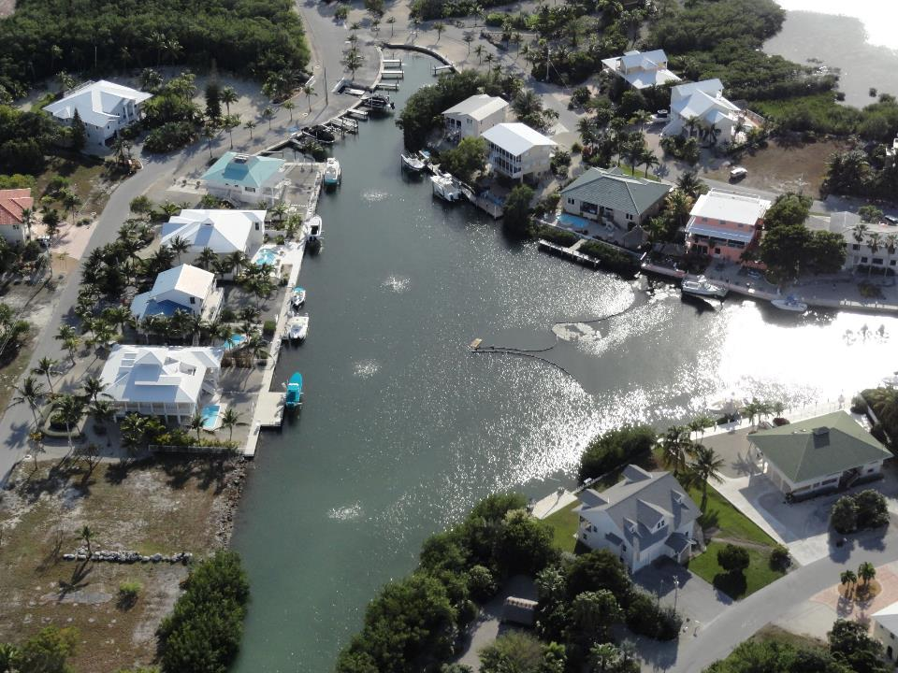
Aeration System – thanks to Parenti – proven to be very valuable

Slide 16
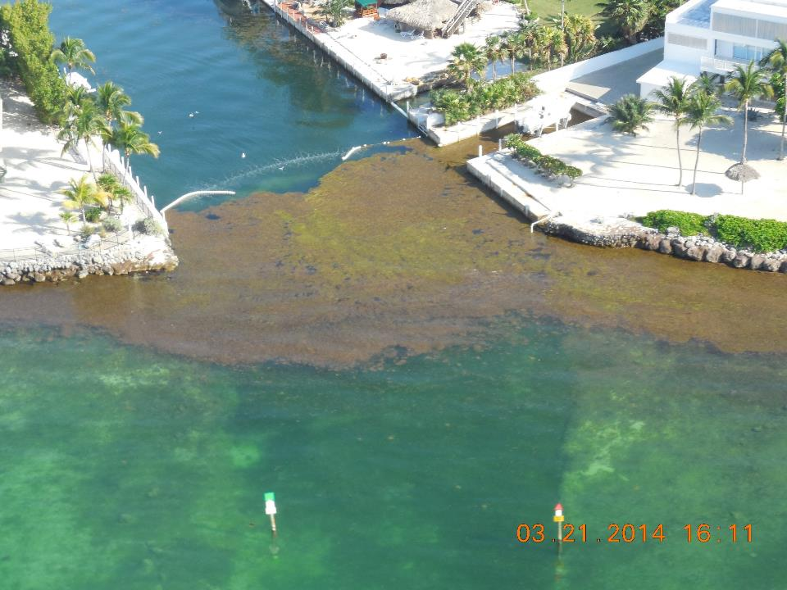
By pulling a bunch of technical tricks out of his hat Dr Bob has gotten the main weed gate to work well with a way undersize blower. See Photo.
That blower keeps burning bearings due to undersize wire to the blower pad. So Dr Bob has to load the blower by back hoe into his pickup, take it to Miami, then go get it and reinstall it twice a year plus maintain the floating netting. In addition, engineering plans for our weed gate called for a 7.5 hp blower which Dave Bumbaugh donated to us. It would allow a more robust seaweed barrier and eliminate much of the floating netting and maintenance.

Slide 17
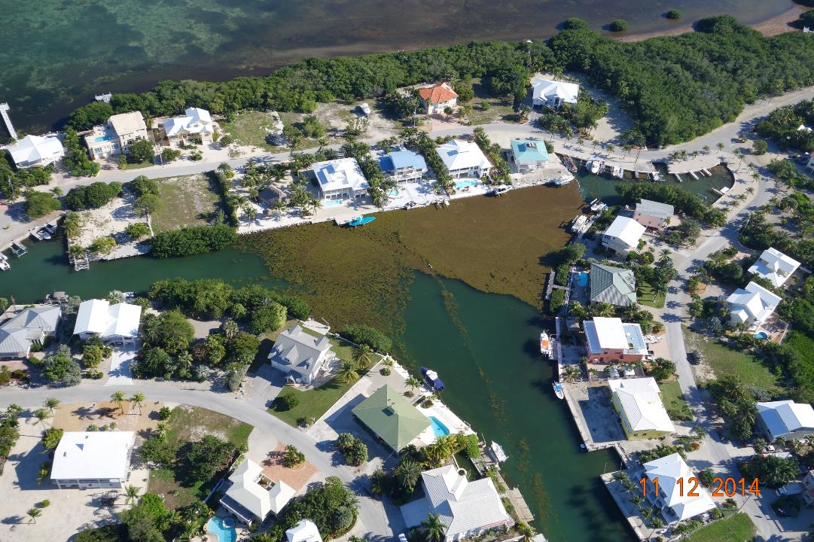
Helbig, Alexander, Bucetta & others have threatened to sue SKHOA over impaired use & enjoyment, degraded property values, etc. Our members adversely impacted by the dense deep mattress of stinking seaweed shown have just cause to threaten similar action per our By-Laws. The solution is easy, fix the main weed gate. We have all the expensive components.

Slide 18
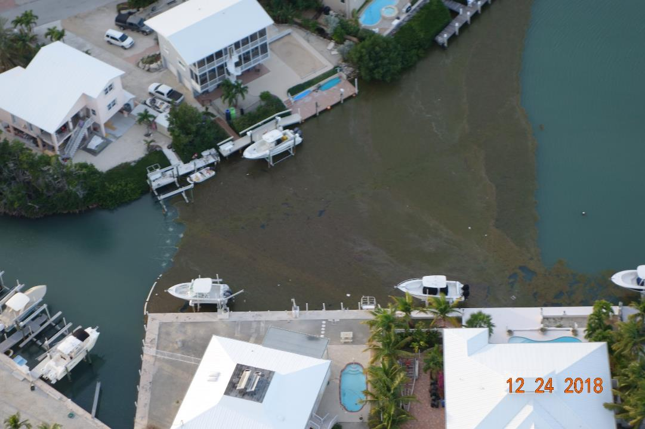
--------------------------
Inner seaweed barrier between Fran Mear’s and Harlan Petitt’s
Members rights under SKHOA By-Laws are being ignored. Fix the main weed gate.

Slide 19
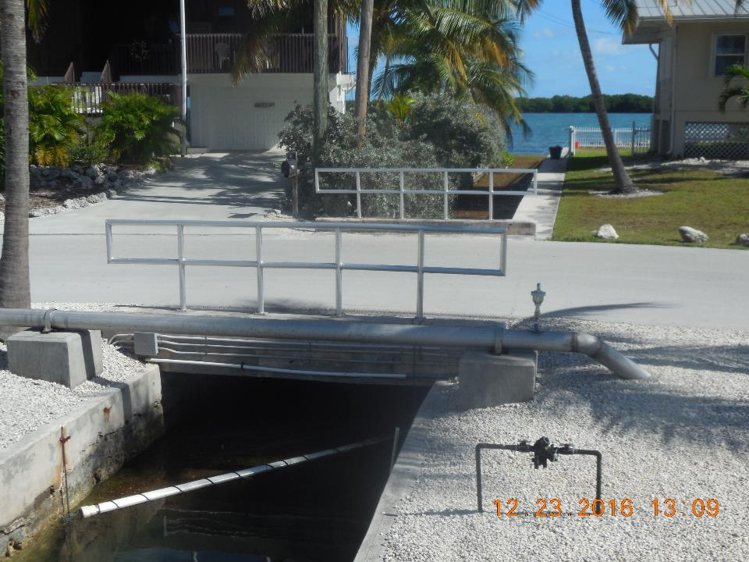
Seaweed was captured in the second flushing canal, rotted, sank and was carried by strong current under this barrier into the Windy Point marina where it settles as current flow dissipates - constantly adding to the anaerobic (toxic) muck in that marina.
SEE NEXT PHOTO! IT IS UNDENIABLE !

Slide 20
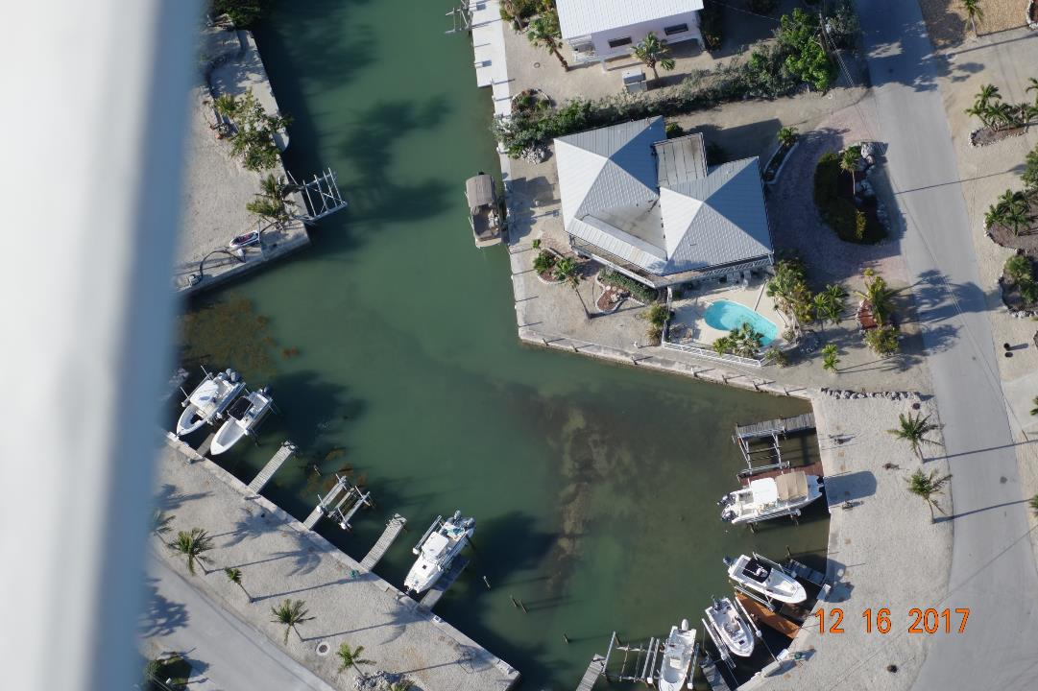
WHY HAVE WE ALLOWED THIS TO CONTINUE?
Awful muck up to surface in this marina at low tide!!
UNACCEPTABLE
Member rights under By- Laws are being violated -------
See muck up to surface ----
---------

Slide 21
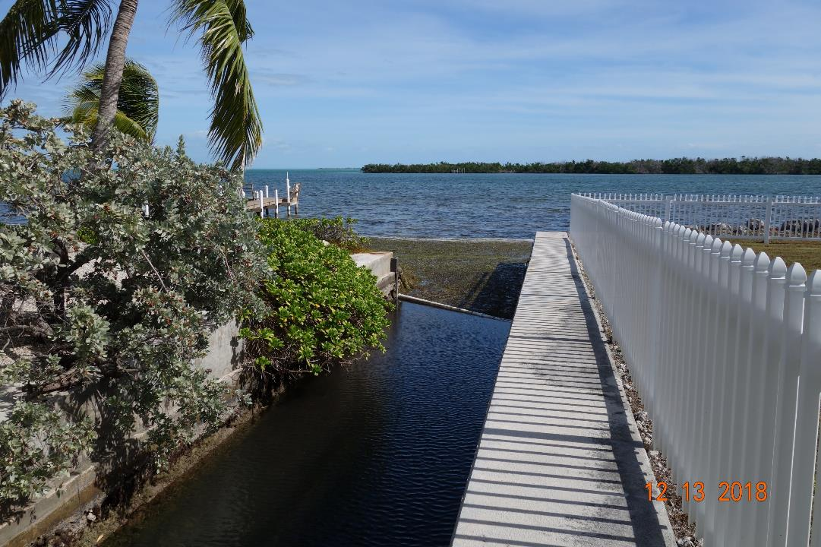
Dr Bob recently built and installed a new seaweed barrier at the canal entrance. This is a MAJOR improvement in preventing constant rotting seaweed flow into the second marina – it also eliminated the stinking rotting mass held along Teget’s and the church house inside the length of the flushing canal from the entrance to the bridge. And Why is this his responsibility? We can afford to hire a crew.

Slide 22
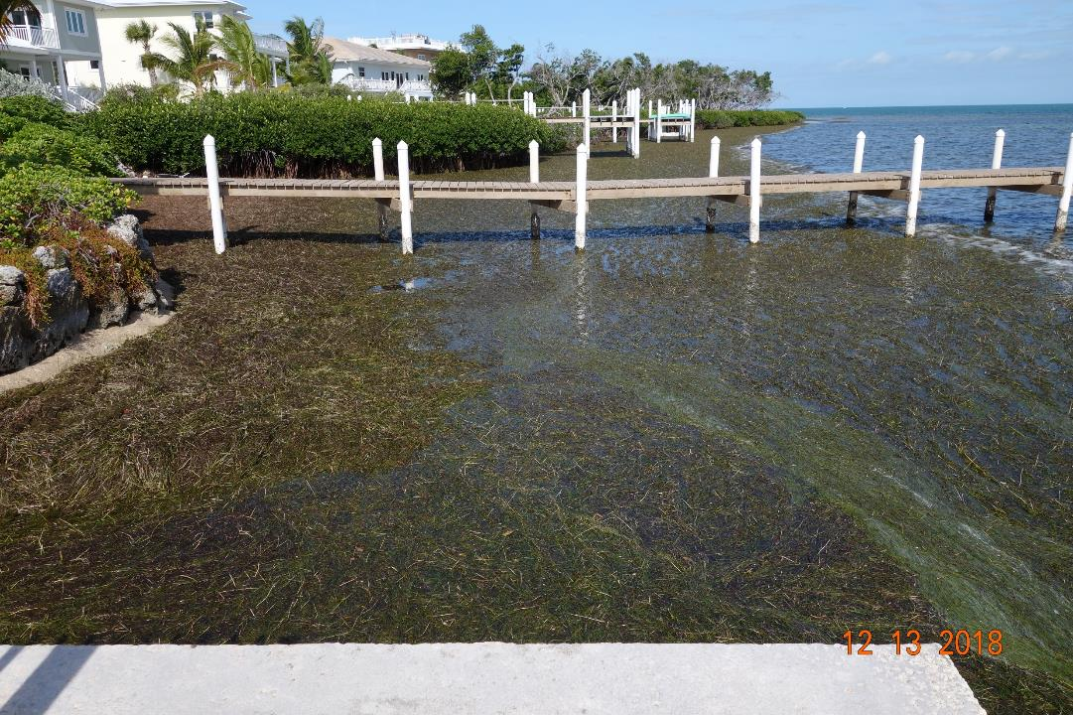
A floating net type barrier from the seawall (fore-ground) to the mangroves is the next action we need - to hold seaweed away from strong current at the canal opening. Cheap!

Slide 23
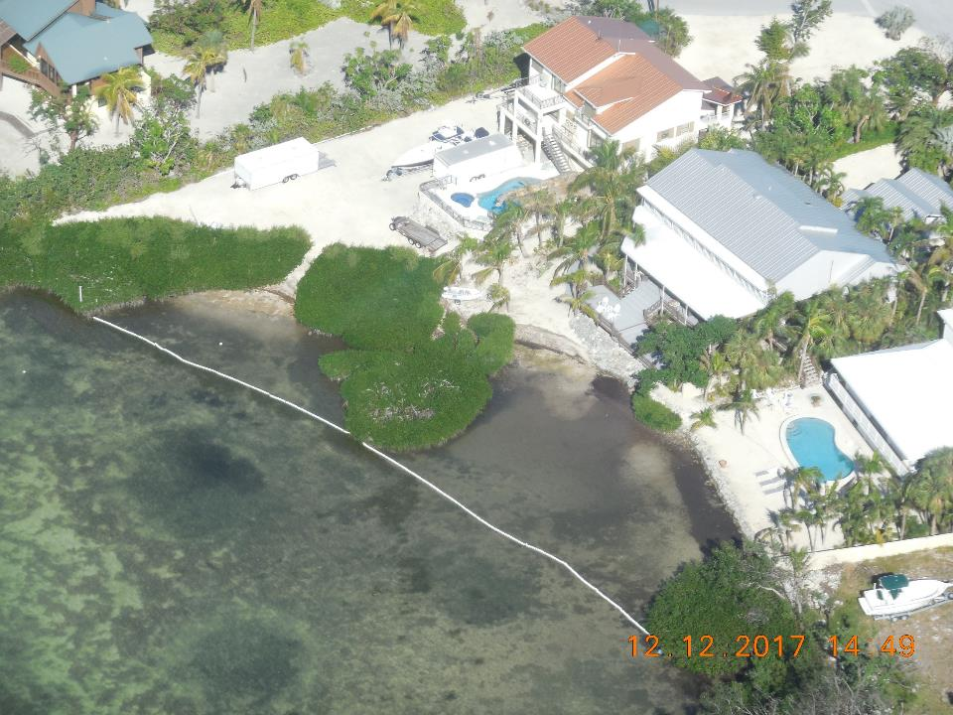
Here
If done properly and maintained the floating net works well. Note actual beach without seaweed in the upper netting area
The open waterfront is not platted on county records as SKHOA property so these nets lines were not paid for by the association.

Slide 24
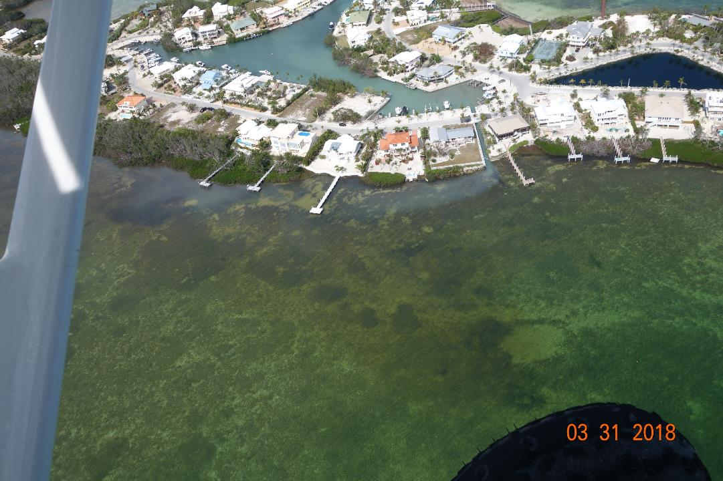
This plume of contaminated water flowing out of our second marina into Florida Bay is a gross violation of law and due to rotting, anaerobic seaweed sediment in that marina.

Slide 25
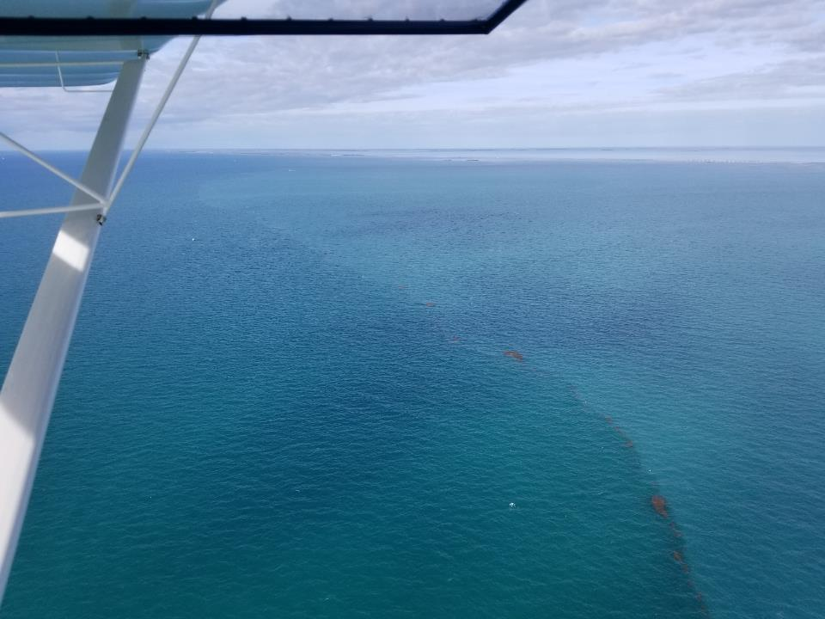
Aerial view showing the color change between two areas of contaminated water, blue green (cyanobacteria) algae left and grey green right, all flowing out from Keys canals and Florida Bay over the reef – Our canal is contributing to this Violation US Congress Clean Water Act as well as a series of State of Florida Statutes. We clearly contribute to the problem.

Slide 26
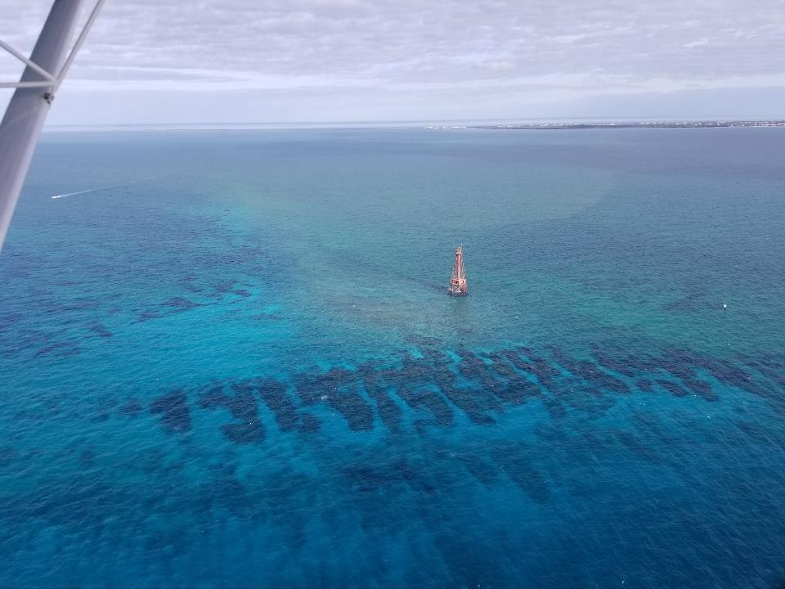
Aerial view of Sombrero Light and reef- Note clean blue ocean water bottom left, blue green algae laden water on the right side of the reef and broad area of grey brown polluted water behind the light in the photo. These are referred to by marine scientists as the “HALO EFFECT OF IMPAIRED WATER” from Keys canals and Florida Bay that extends out over the reef and adversely impacts the reef ecosystem.

Slide 27
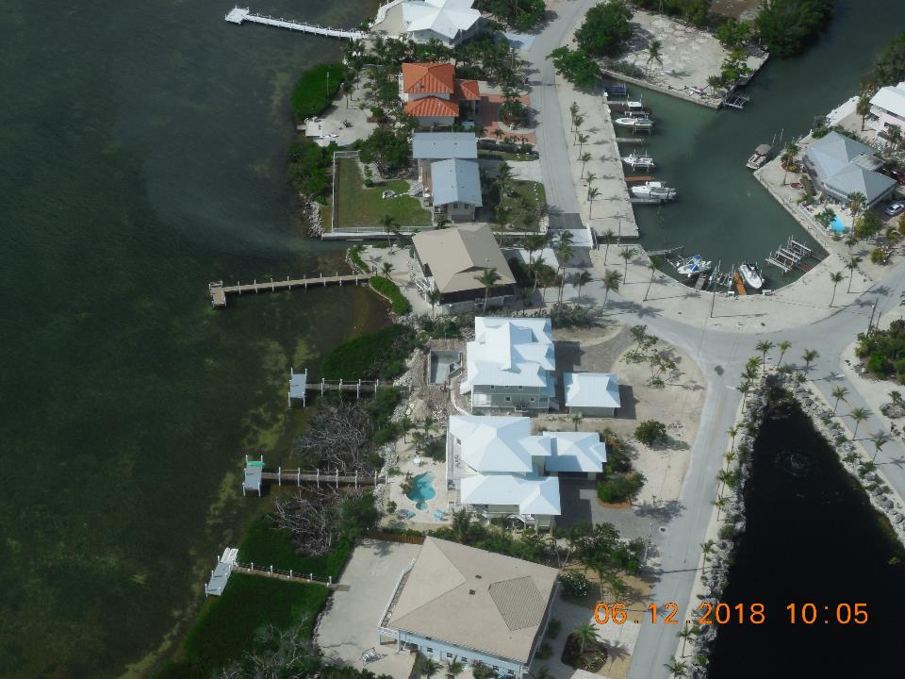
---------------------
-----------
Plume of contaminated water flowing out of flushing canal –Stirrup Key, unacceptable.

Slide 28
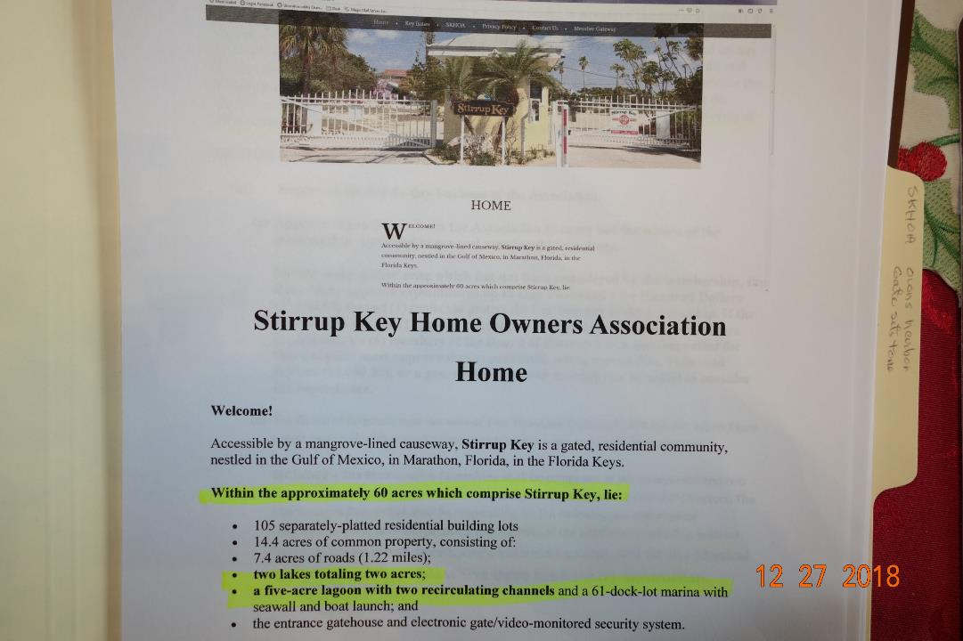
SKHOA owns the canals, so, We own the problem

Slide 29
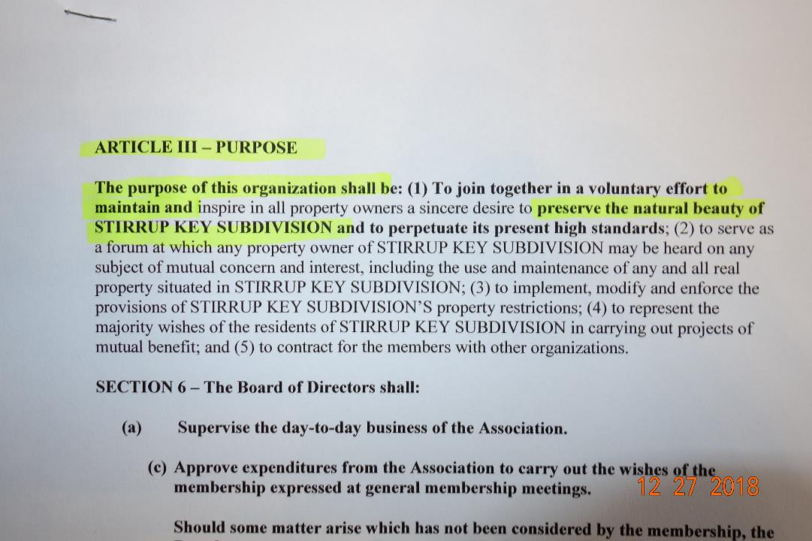
Under the legal documents that establish SKHOA our home owners association (that is us) is required to maintain the community, preserve its natural beauty, and inspire our members to do the same.

Slide 30
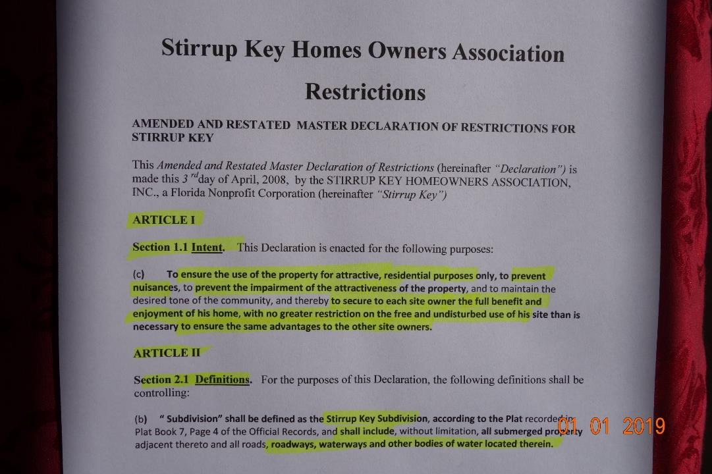
We are not carrying out our responsibilities to the community and particularly not for our adversely impacted members

Slide 31
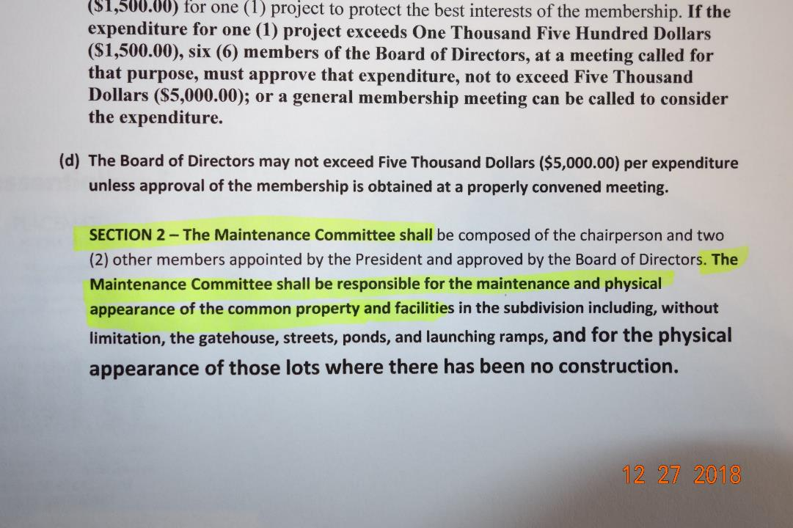
Again, SKHOA is obligated under the Master Declarations that establish our HOA as a legal entity to address these problems.

Slide 32
Again, Helbig, Alexander, Bucetta & others have threatened to sue SKHOA over impaired use & enjoyment, degraded property values, etc.
Members have grievance under SKHOA By-Laws, and can sue SKHOA. We should not force them to do so to get SKHOA to act properly.

Slide 33
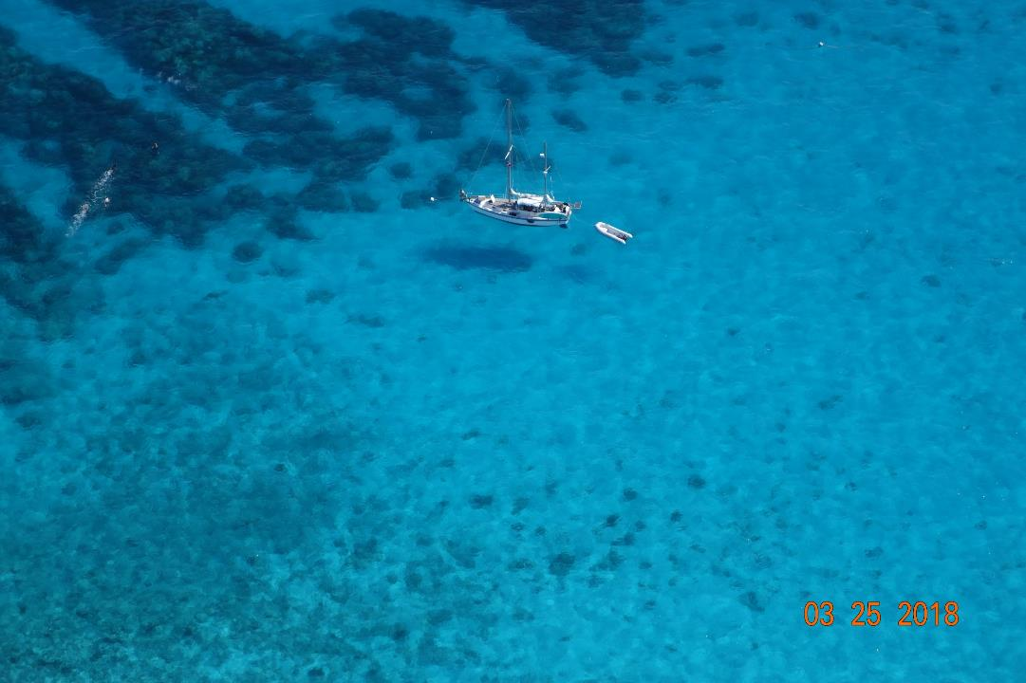
We (SKHOA) have both ethical and legally established responsibility under multiple statutes not just to protect the interests of our adversely impacted members but to take steps to control harmful effluent flowing from our community into our Florida Keys ecosystem

Slide 34
The County & City have USDA grant money to clear debris from 75 canals after Irma. Residents who worked directly with officials, face to face, as the grant implementation developed found out how to qualify, while others who did not were left out. I met with George Garrett of the City at routine meetings and sent him a letter with photos trying to get us on the list. So Adventure Environmental came into SKHOA with a crane and divers to remove debris. Another 100 canals were added to debris removal because residents took action, even “plugged” canals that are not open to the Florida Bay or the ocean. And the County will still turn back a lot of unspent USDA funding. The POINT is: We need management that is in THE MIDDLE OF THE ACTION AND ACTING ON OUR BEHALF. I do not want to continue spending my time doing all of this. I am not that guy anymore. The cheap simple solution is to PAY someone who is already doing this for many HOAs and Condo associations. And keep in mind that by the time our volunteer officers and board members read about what has happened in the news paper or on the County web site its too little and usually too late to take steps to be included in grant funding. If our agent is not face to face with government grant managers, our members may lose out on canal muck removal funding and that could cost us $10,000 per lot.
The next big item the County is constantly talking about is securing grant funds to dredge canals. This is a big ticket item. We need a professional who tracks this, is on a first name basis with the proper grant coordinators, permitting officials, local DEP and Army Corps decision makers, have engineers and contractors lined up and ready. Our Bylaws have to allow quick action and SKHOA financial resources have to be ready to go if some matching funds are needed.

Slide 35
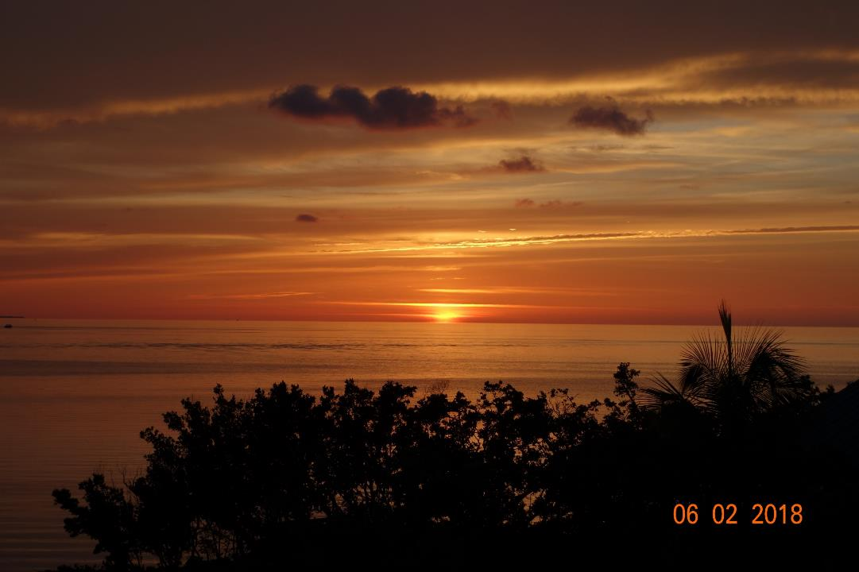
Next Step For This Amazing Gem Called – Stirrup Key

Slide 36
Motion: The membership directs the association to take action on the following priorities. (The Motion Passed)
Get the main weed gate back in service (FKRAD)
Install new breaker panel for boat ramp marina and equipment pad – The current panel is full
Run heavier electrical service to the blower & aeration equipment pad
Install 7.5 hp blower and VFD that was donated to SKHOA by member Dave Bumbaugh several years ago (FKRAD)
Hire labor to maintain seaweed barriers and aeration system (FKRAD)
Maintain & enhance flushing canals for Clean Water Act FKRAD compliance
Pump sludge out of Windy Point marina or clear it otherwise (FKRAD)
Track canal water quality meetings, grant funding, particularly for canal sludge removal, canal residents taxing plans and the progress on the FKRAD. Take necessary steps to avoid being taxed for what we have already done at our own expense. Keep the board informed. (Work directly and closely with government decision makers and their environmental consultants to understand how to benefit from funding and avoid excess taxation. Work with our political representatives as needed to move our objectives.)
Tap Dr Bob’s knowledge and technical expertise throughout. drjones7788@gmail.com

Slide 37
Impaired water flowing out of Stirrup Key harbor is unacceptable. Lets get our main weed gate back in operation and get the Windy Point marina addressed.

Slide 38
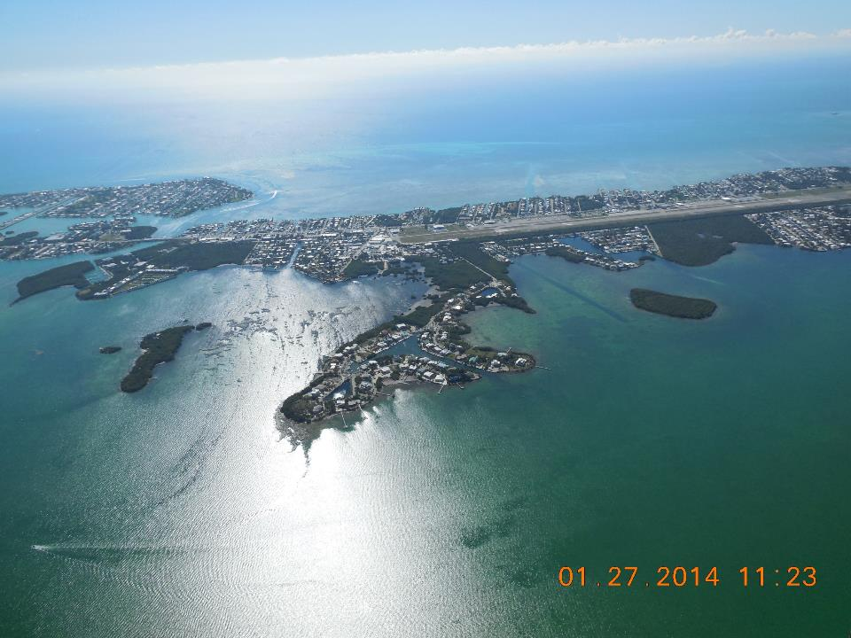
Stirrup Key is an absolute one of a kind GEM. We need to take care of it.

